Slide 1

Gabriela Yordanova

Slide 2

Who am I and how I approach the project
I am a person with no programming background
I was trying to follow all instructions given in the Project Specifications
Break down all of the tasks into smaller ones

Slide 3
What technologies I learned for this project
Java
Jira
Github
Maven

Slide 4
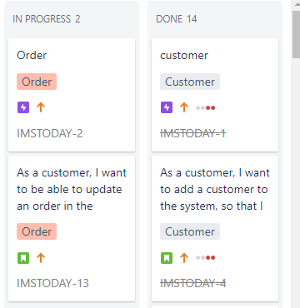
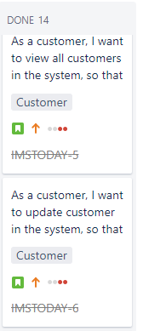
Jira

Slide 5
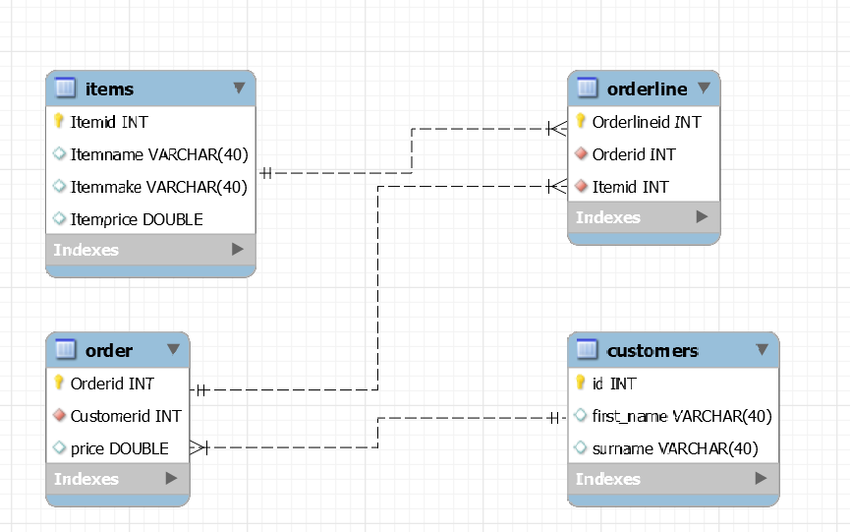
ERD Diagram

Slide 6
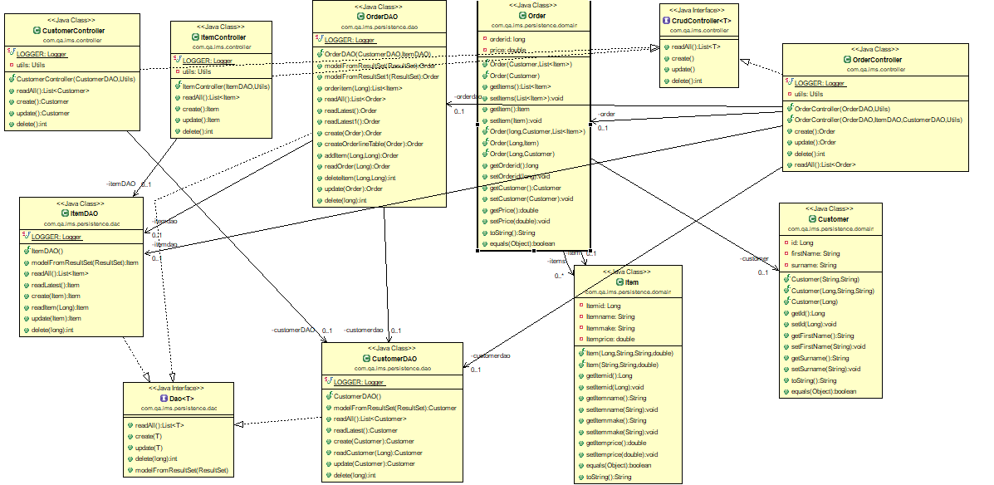
UML Diagram

Slide 7
What I managed to complete and what I left behind
I managed to create a working program
The style of code could have been cleaner
I struggled with testing my OrderController and that is the bit I have not done therefore my coverage is less than 80%

Slide 8
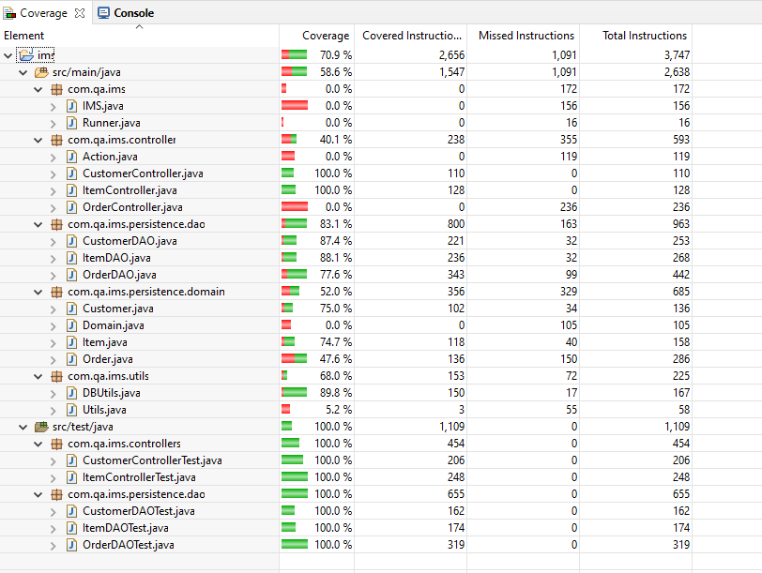
Coverage and testing

Slide 9
What went well and what could be improved
I managed the do the coding for the Items quicker than the
I got stuck on coding the Orders
Due to lack of experience, I wasted a lot of time on easy bits that if I had the experience I would have not get stuck on them.
My order Controller code could be slightly improved

Slide 10
Future steps
Very good experience
In the future, I want to manage my time a bit better and do a bit more research on how to approach the problems
I have expanded my knowledge quite a bit for the past five weeks

Slide 11
Questions?

